Slide 1







ImagenHub: Standardizing the evaluation of conditional image generation models
♠️Max Ku, ♠️Tianle Li, †Kai Zhang, ♣Yujie Lu, ♥Xingyu Fu, ♢Wenwen Zhuang, ♠️Wenhu Chen
♠️University of Waterloo, †Ohio State University, ♣University of California Santa Barbara, ♥University of Pensylvania, ♢Central South University
tiger-ai-lab.github.io/ImagenHub
Notes:
Hi, this is Max speaking. We present ImagenHub: Standardizing the evaluation of conditional image generation models.

Slide 2
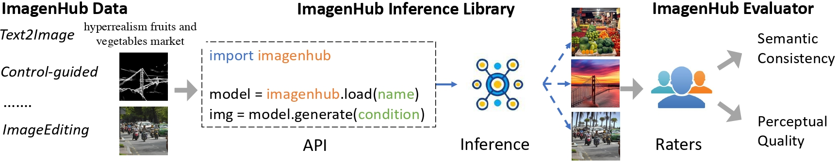
ImagenHub
Notes:
ImagenHub is a unified inference and evaluation framework for a large variety of conditional image generation models.
First, we developed high-quality evaluation datasets specifically designed for seven major conditional image generation tasks, ensuring comprehensive and relevant test scenarios.
Then, we use the ImagenHub inference library which standardizes the inference process across different conditional image generation models, generating synthetic data for evaluation.
The ImagenHub inference library is not just a collection of code; it's a software designed to ensure that all models are evaluated in a fair environment. It contains standardized datasets, a unified inference pipeline, and clear documentation to support researchers and developers. This library is easily extendable, allowing for the integration of new models and tasks as the field evolves.
To better resonate with human perception, we introduced two innovative human evaluation metrics: Semantic Consistency and Perceptual Quality. These metrics can be combined into an overall score, enabling fair and consistent comparisons across models.

Slide 3
Motivation
Research community has to identify the models reliability
Showing true progress of the field
Standardizing Human evaluation
To compare models on a fair platform
Notes:
The motivation for ImagenHub stems from a clear need in the research community. Despite the rapid development of numerous image generation models, significant inconsistencies in datasets, inference methods, and evaluation metrics have made it difficult to fairly compare these models. These challenges hinder the understanding of true progress in the field. ImagenHub addresses these issues by providing the standardized tools.

Slide 4
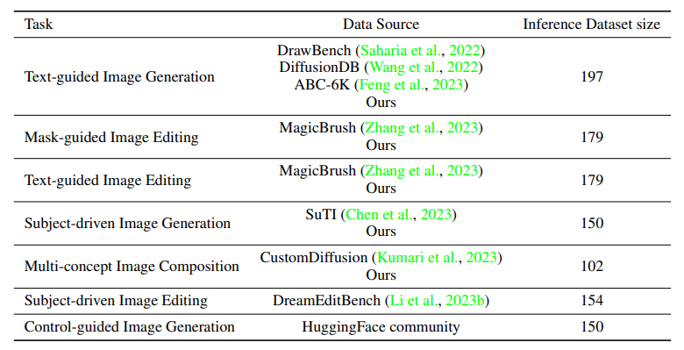
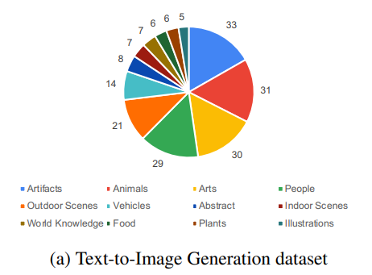
Inference Dataset
Notes:
We evaluate the seven conditional image generation tasks with tailored inference datasets, each featuring a rich mix of categories, carefully sized to enable swift human evaluation while ensuring a robust and comprehensive benchmark.

Slide 5
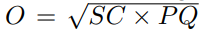
Human Evaluation
Semantic Consistency (SC) in range [0, 0.5, 1]
how well the generated image is aligned with the condition X
Perceptual Quality (PQ) in range [0, 0.5, 1]
how well is the image quality of the generated image
Overall (O)
Geometric mean of two aspects
Notes:
Our evaluation process employs three human judges per model to measure Semantic Consistency—how closely an image matches its specified conditions—and Perceptual Quality—the visual excellence of the image. These two criteria with a three-tier rating system to speed up the evaluation while ensuring reliability. The two metrics are combined into an Overall score using a geometric mean.

Slide 6
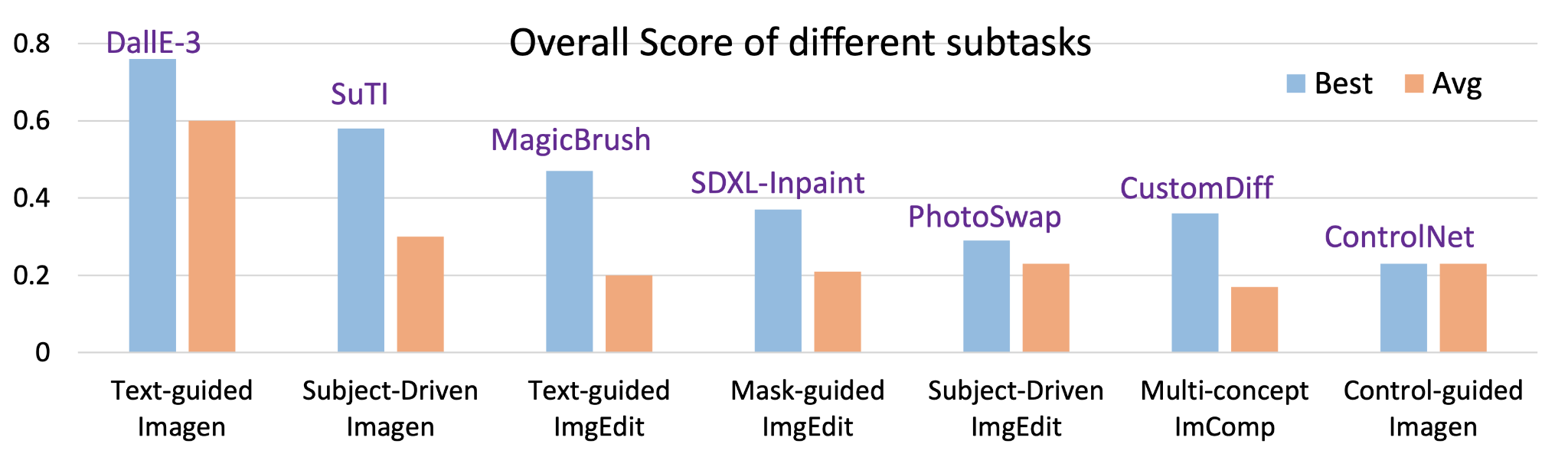
Results
Notes:
Let's talk about the results of ImagenHub. Our evaluations covered around 30 different models, and we observed that the existing models’ performance is generally unsatisfying, but there are exceptions include the high scores of Dall-E-3 in Text-guided Image Generation and SuTI in Subject-Driven Image Generation, MagicBrush is performing well in Text-guided ImgEdit.

Slide 7
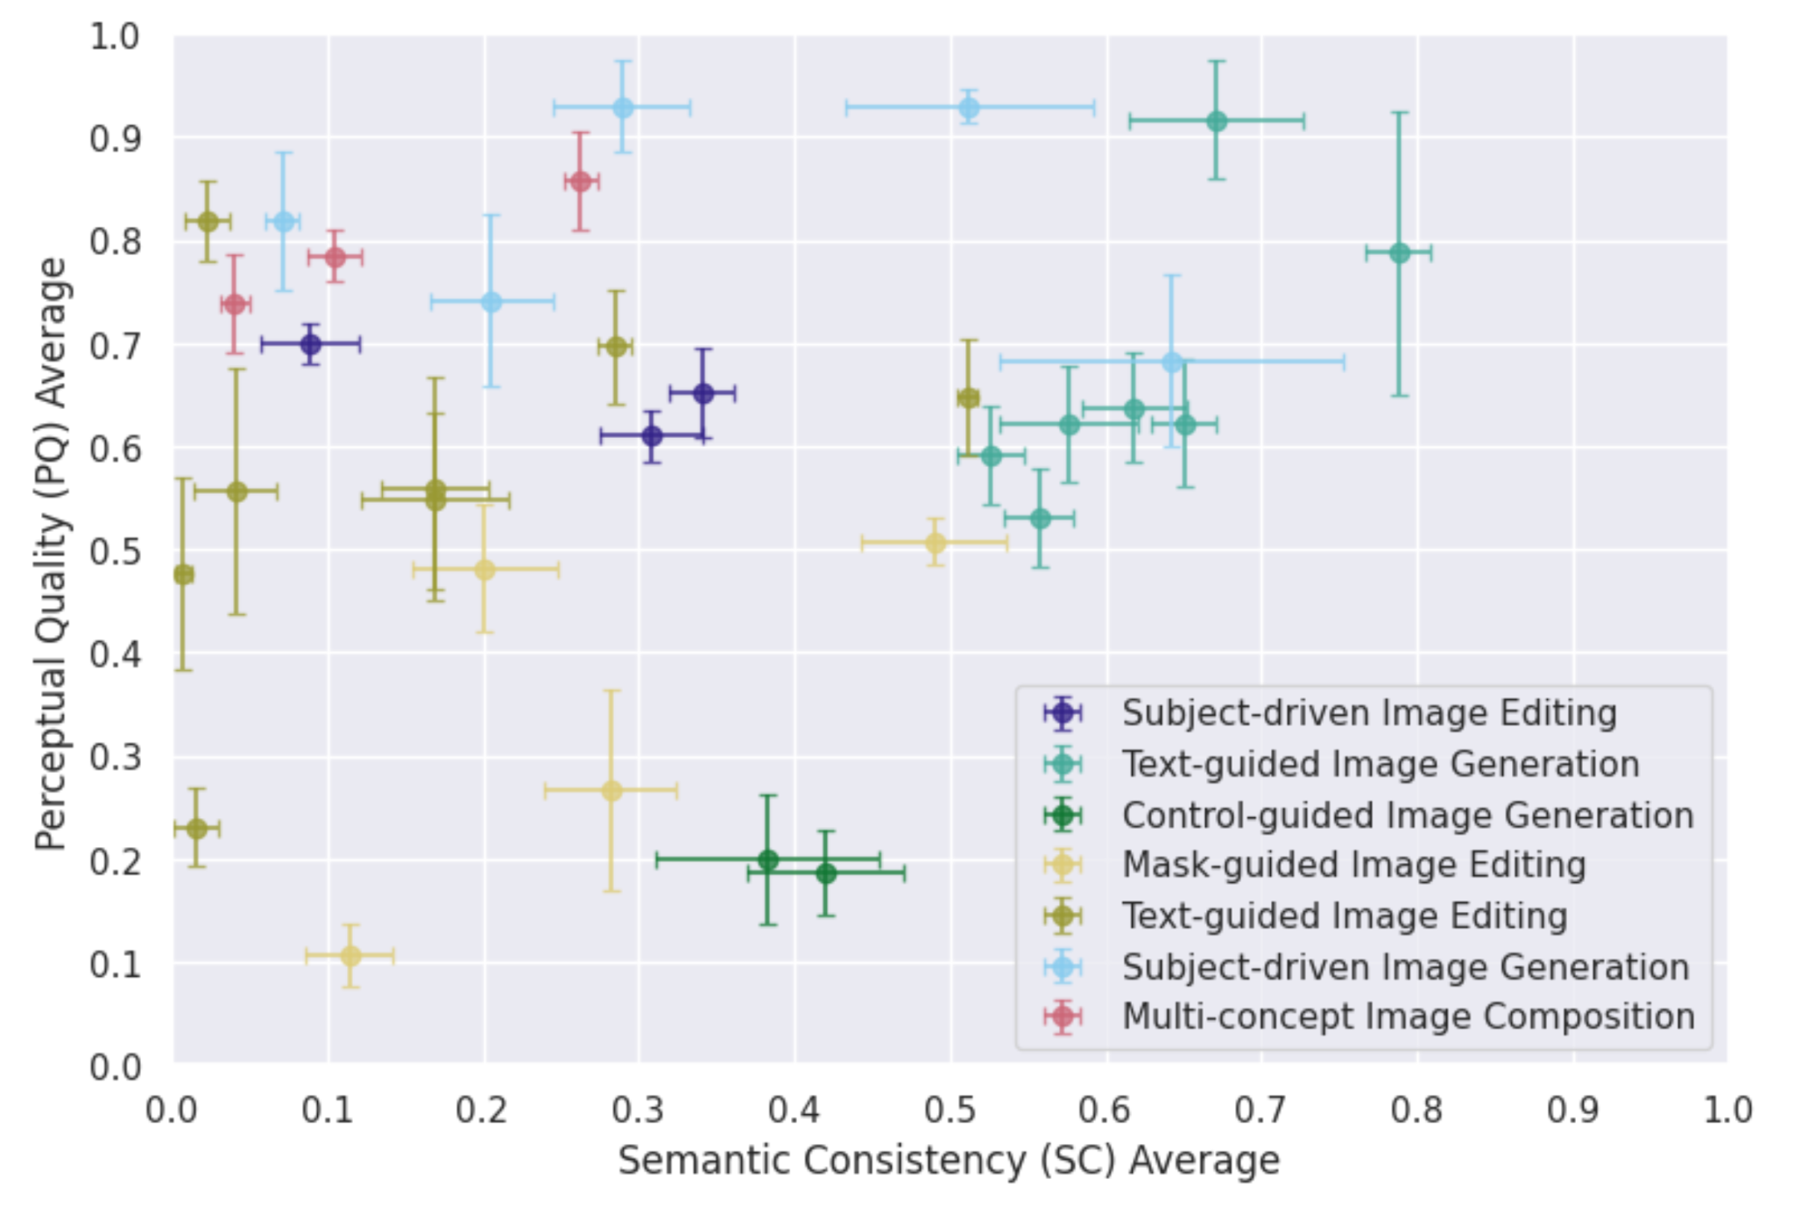
Notes:
Examine the score distribution in detail, it reveals significant performance variations. Only tasks like Text-guided and Subject-driven Image Generation are giving satisfactory results.

Slide 8
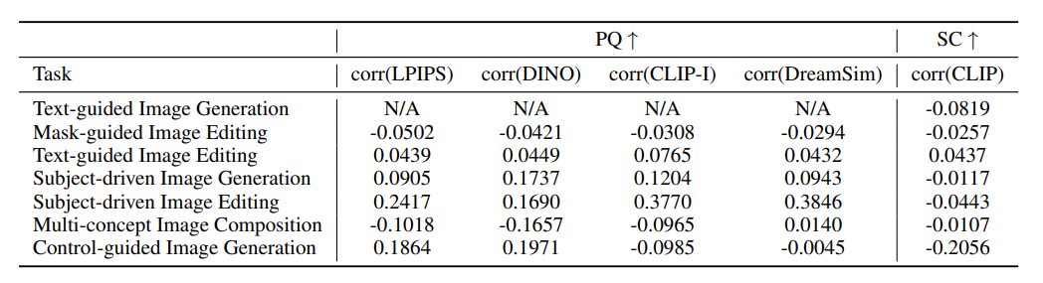
Notes:
Another critical finding was the low correlation between existing automatic metrics and human judgments, highlighting the need for our human-centered evaluation metrics.

Slide 9
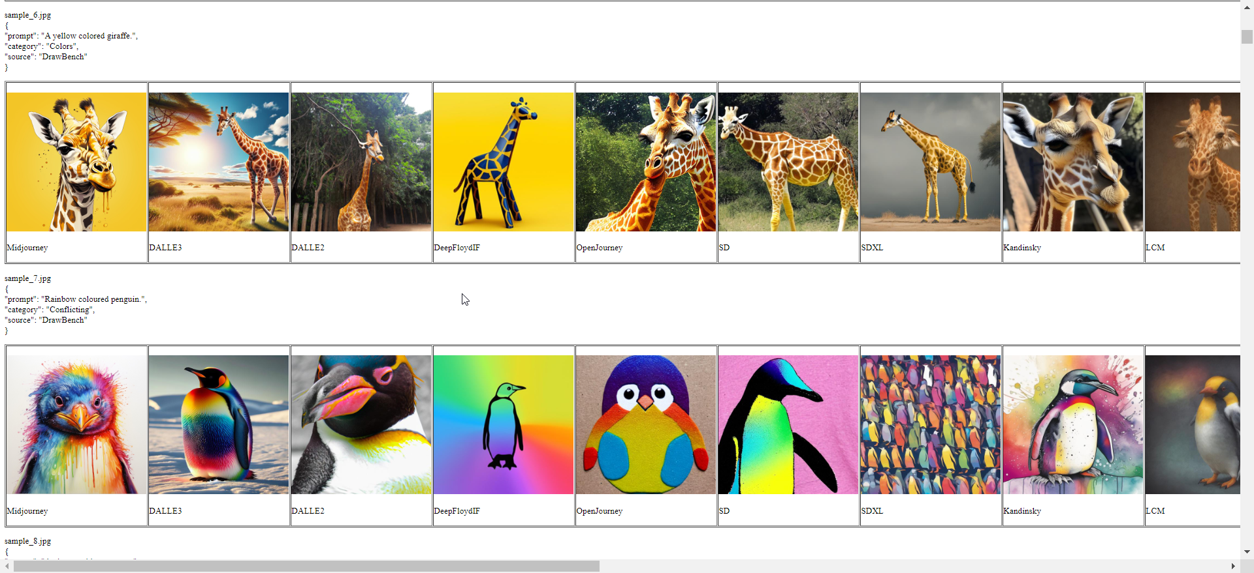
Imagen Museum
Notes:
Our project is designed to be continuous and open source, encouraging ongoing updates and community collaboration, which are crucial for keeping pace with rapid advancements in the field. We hosted a webpage called Imagen Museum to show all the generated data across all models, allowing people to access the actual performance of the models with ease.

Slide 10
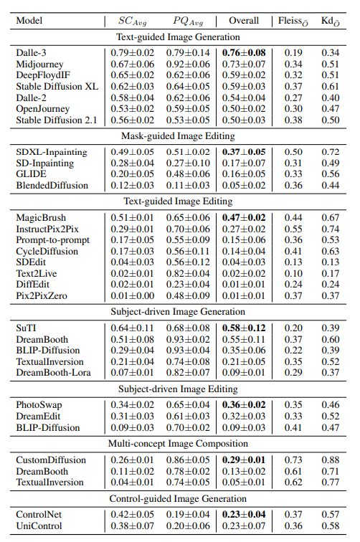
Leaderboard
Notes:
In conclusion, ImagenHub represents a pivotal step towards more reliable and meaningful evaluations of image generation models. We are continuously updating our library, include more models on the leaderboard. Our goal is not only to track progress but also to foster a more collaborative and transparent research environment.

